Slide 1
SEWDL- MODULE 6

Slide 2
Risk management
A risk is a probable problem- it might happen or it might not. There are main two characteristics of risk
Uncertainty- the risk may or may not happen that means there are no 100% risks.
loss – If the risk occurs in reality , undesirable result or losses will occur.
Risk management is a sequence of steps that help a software team to understand , analyze and manage uncertainty.

Slide 3
Risk strategy
Reactive risk strategies
  "Don't worry, I'll think of something"
  The majority of software teams and managers rely on this approach
  Nothing is done about risks until something goes wrong
Proactive risk strategies
  Steps for risk management are followed
  Primary objective is to avoid risk and to have a contingency plan in place to handle unavoidable risks in a controlled and effective manner

Slide 4
RISK IDENTIFICATION
Risk identification is a systematic attempt to specify threats to the project plan (estimates, schedule, resource loading, etc.)
One method for identifying risks is to create a risk item checklist.
The checklist can be used for risk identification and focuses on some subset of known and predictable risks in the following generic subcategories:
Product size —risks associated with the overall size of the software to be built or modified.
Business impact —risks associated with constraints imposed by management or the marketplace.

Slide 5
Risk Identification
The project organizer needs to anticipate the risk in the project as early as possible so that the impact of risk can be reduced by making effective risk management planning.
A project can be of use by a large variety of risk. To identify the significant risk, this might affect a project. It is necessary to categories into the different risk of classes.

Slide 6

There are different types of risks which can affect a software project:
Technology risks: Risks that assume from the software or hardware technologies that are used to develop the system.
People risks: Risks that are connected with the person in the development team.
Organizational risks: Risks that assume from the organizational environment where the software is being developed.
Tools risks: Risks that assume from the software tools and other support software used to create the system.
Requirement risks: Risks that assume from the changes to the customer requirement and the process of managing the requirements change.
Estimation risks: Risks that assume from the management estimates of the resources required to build the system

Slide 7
Methods for Identifying Risks
Earlier, there were no easy methods available that will surely identify all risks. But nowadays, there are some additional approaches available for identifying risks. Some of approaches for risk identification are given below:
Checklist analysis
Brainstorming
Casual Mapping
SWOT analysis

Slide 8

Checklist Analysis
Checklist Analysis is type of technique generally used to identify or find risks and manage it.
The checklist is basically developed by listing items, steps, or even tasks and is then further analyzed against criteria to just identify and determine if procedure is completed correctly or not.
It is list of risk that is just found to occur regularly in development of software project.

Slide 9
Brainstorming
This technique provides and gives free and open approach that usually encourages each and everyone on project team to participate.
It also results in greater sense of ownership of project risk, and team generally committed to managing risk for given time period of project.
It is creative and unique technique to gather risks spontaneously by team members.
The team members identify and determine risks in ‘no wrong answer’ environment.
This technique also provides opportunity for team members to always develop on each other’s ideas.
This technique is also used to determine best possible solution to problems and issue that arises and emerge.

Slide 10

Casual Mapping
Causal mapping is method that builds or develops on reflection and review of failure factors in cause and effect of the diagrams.
It is very useful for facilitating learning with an organization or system simply as method of project-post evaluation.
It is also key tool for risk assessment.

Slide 11
SWOT Analysis
Strengths-Weaknesses-Opportunities-Threat (SWOT) is very technique and helpful for identifying risks within greater organization context.
It is generally used as planning tool for analyzing business, its resources, and also its environment simply by looking at internal strengths and weaknesses and opportunities and threats in external environment.
It is technique often used in formulation of strategy.
The appropriate time and effort should be spent on thinking seriously about weaknesses and threats of organization for SWOT analysis to more effective and successful in risk identification.

Slide 12
Risk Components
PM identify the risk drivers that affect software risk components:
Performance risk—the degree of uncertainty that the product will meet its requirements and be fit for its intended use.
Cost risk—the degree of uncertainty that the project budget will be maintained.
Support risk—the degree of uncertainty that the resultant software will be easy to correct, adapt, and enhance.
Schedule risk—the degree of uncertainty that the project schedule will be maintained and that the product will be delivered on time.

Slide 13
Risk drivers/ impact levels
The impact of each risk driver on the risk component is divided into one of four impact levels
  Negligible-4,
  Marginal-3,
  Critical-2, and
  Catastrophic-1
Risk drivers can be assessed as impossible, improbable, probable, and frequent

Slide 14
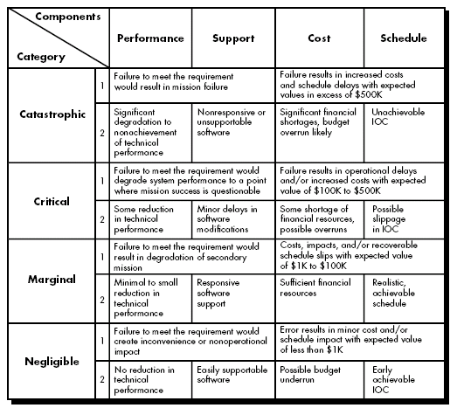

Slide 15
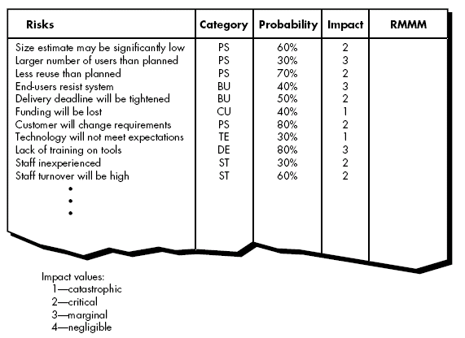

Developing Risk Table

Slide 16
Procedure to build risk table
Listing all risks in first column.
  This can be accomplished with the help of the risk item checklists
Each risk is categorized in the second column
The probability of occurrence of each risk is entered in the next column of the table.
  Which can be estimated by team members.
Impact of each risk is assessed.
  Each risk component is assessed using the characterization and an impact categories like catastrophic, critical, marginal and negligible are determined.
Once table is completed, manger will give order of prioritization to the risk. Therefore, the table is sorted by probability and by impact.

Slide 17
High-probability, high-impact risks get into the top of the table, and low-probability risks drop to the bottom. (First order prioritization).
The project manager studies the resultant sorted table and defines a cutoff line.
The cutoff line implies that only risks that lie above the line will be given further attention.
Risks that fall below the line are considered as second-order prioritization.
All risks that lie above the cutoff line must be managed and specify in last column of the table under RMMM column.

Slide 18
Risk Assessment
Risk assessment simply means to describe the overall process or method to identify risk and problem factors that might cause harm.
It is actually a systematic examination of a task or project that you perform to simply identify significant risks, problems, hazards, and then to find out control measures that you will take to reduce risk.
The best approach is to prepare a set of questions that can be answered by project managers in order to assess overall project risks.

Slide 19
These questions are shown below:
Will the project get proper support from the customer manager?
Are end-users committed to software that has been produced?
Is there a clear understanding of the requirements?
Is there an active involvement of customers in the requirement definition?
Are the expectations set for the product are realistic?
Is project scope stable?
Are there team members with the required skills?
Are project requirements stable?
Does technology used for software is known to developers?
Is the size of the team sufficient to develop the required product?
Is that all customers know the importance of the product/requirements of the system to be built?

Slide 20
Thus, the number of negative answers to these questions represents the severity of the impact of risk on the overall project.
It is not about creating or making a large number of work papers, but rather simply identify and find out measures to control risks in your workplace.

Slide 21
Risk Mitigation, Monitoring,and Management
RMMM - Mitigation, Monitoring, and Management
An effective strategy for dealing with risk must consider three issues
  Risk mitigation is a problem avoidance activity
  Risk monitoring is a project tracking activity
  Risk management includes contingency plans that risk will occur

Slide 22
Risk Mitigation
Risk mitigation (avoidance) is the primary strategy and is achieved through a plan
For Ex., Risk of high staff turnover
  To mitigate this risk, you would develop a strategy for reducing turnover.
  The possible steps to be taken are:
    Meet with current staff to determine causes for turnover (e.g., poor working conditions, low pay, and competitive job market)
    Mitigate those causes that are under your control before the project starts
    Once the project commences, assume turnover will occur and develop techniques to ensure continuity when people leave
    Organize project teams so that information about each development activity is widely dispersed
    Define work product standards and establish mechanisms to be sure that all models and documents are developed in a timely manner
    Conduct peer reviews of all work (so that more than one person is “up to speed”).
    Assign a backup staff member for every critical technologist

Slide 23
Risk Monitoring
The project manager monitors factors that may provide an indication of whether the risk is becoming more or less likely.
In the case of high staff turnover, the general attitude of team members based on project pressures, the degree to which the team has jelled, inter-personal relationships among team members, potential problems with compensation and benefits, and the availability of jobs within the company and outside it are all monitored.
In addition to monitoring these factors, a project manager should monitor the effectiveness of risk mitigation steps.
The project manager should monitor work products carefully to ensure that each can stand on its own and that each imparts information that would be necessary if a newcomer were forced to join the software team somewhere in the middle of the project.

Slide 24
Risk Management
Risk management and contingency planning assumes that mitigation efforts have failed and that the risk has become a reality.
If the mitigation strategy has been followed, backup is available, information is documented, and knowledge has been dispersed across the team.
In addition, you can temporarily refocus resources (and readjust the project schedule) to those functions that are fully staffed, enabling newcomers who must be added to the team to “get up to speed.” Those individuals who are leaving are asked to stop all work and spend their last weeks in “knowledge transfer mode.”

Slide 25
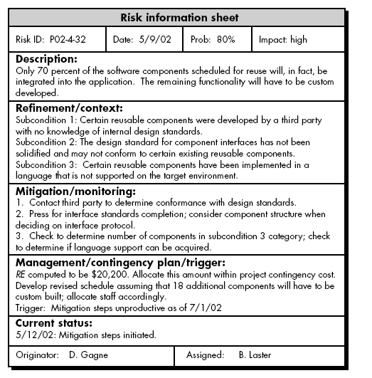


Slide 26
Software Configuration management,
SCM repositories,
SCM process

Slide 27
Software configuration management - SCM
Software configuration management is a set of activities that have been developed to manage change throughout the life cycle of computer software.
SCM can be viewed as a software quality assurance activity that is applied throughout the software process.

Slide 28
It is an umbrella activity that is applied throughout the software process
It's goal is to maximize productivity by minimizing mistakes caused by confusion when coordinating software development
SCM identifies, organizes, and controls modifications to the software being built by a software development team
SCM activities are formulated to identify change, control change, ensure that change is being properly implemented, and report changes to others who may have an interest

Slide 29
Elements of SCM
Component elements—a set of tools coupled within a file management system (e.g., a database) that enables access to and management of each software configuration item.
Process elements—a collection of actions and tasks that define an effective approach to change management (and related activities) for all constituencies involved in the management, engineering, and use of computer software.
Construction elements—a set of tools that automate the construction of software by ensuring that the proper set of validated components (i.e., the correct version) have been assembled.
Human elements—a set of tools and process features (encompassing other CM elements) used by the software team to implement effective SCM.

Slide 30
SCM Process
The software configuration management process defines a series of tasks that have four primary objectives:
  (1) to identify all items that collectively define the software configuration,
  (2) to manage changes to one or more of these items,
  (3) to facilitate the construction of different versions of an application, and
  (4) to ensure that software quality is maintained as the configuration evolves over time.

Slide 31
SCM tasks
Identification
Version Control
Change Control
Configuration Auditing, And
Reporting

Slide 32
Identification
To control and manage software configuration items, each should be separately named and then organized using an object-oriented approach.
Two types of objects can be identified
  basic objects
  aggregate objects.
A basic object is a unit of information that you create during analysis, design, code, or test.
An aggregate object is a collection of basic objects and other aggregate objects.

Slide 33
Each object has a set of distinct features that identify it uniquely:
  Name,
  Description
  list of resources, and
  realization.
The object name is a character string that identifies the object unambiguously.
The object description is a list of data items that identify the SCI type (e.g., model element, program, data) represented by the object, a project identifier, and change and/or version information.
Resources are “entities that are provided, processed, referenced or otherwise required by the object”
  E.g.- data types, specific functions, or even variable names
The realization is a pointer to the “unit of text” for a basic object and null for an aggregate object.

Slide 34
Version Control
Version control combines procedures and tools to manage different versions of configuration objects that are created during the software process.
A number of version control systems establish a change set—a collection of all changes that are required to create a specific version of the software.
change set “captures all changes to all files in the configuration along with the reason for changes and details of who made the changes and when.”

Slide 35
A version control system implements or is directly integrated with four major capabilities:
  (1) a project database that stores all relevant configuration objects,
  (2) a version management capability that stores all versions of a configuration object
  (3) a make facility that enables you to collect all relevant configuration objects and construct a specific version of the software.
  (4)In addition, version control and change control systems often implement an issues tracking (also called bug tracking) capability that enables the team to record and track the status of all outstanding issues associated with each configuration object.

Slide 36
1.0
1.1
1.2
1.3
2.0
2.1
2.1.1
Version control manages different versions of configuration items during the development process

Slide 37
Using a version control system (VCS) provides numerous benefits for individuals and teams collaborating on software development projects.
History and Version Tracking:
  VCS keeps a complete history of changes made to files, allowing developers to track who made what changes and when. This helps in understanding the evolution of the codebase over time.
Code Backup:
  VCS acts as a backup system for code. Even if a local copy of code is lost or corrupted, it can be restored from the repository.
Collaboration:
  VCS enables seamless collaboration among team members, allowing multiple developers to work on the same codebase simultaneously. It eliminates conflicts by providing mechanisms for merging changes made by different developers.

Slide 38
Branching and Merging:
  VCS allows developers to create branches to work on features or fixes independently. Once the changes are complete, branches can be merged back into the main codebase. This facilitates parallel development without disrupting the main codebase.
Experimentation and Risk-Free Development:
  Developers can experiment with new features or changes in separate branches without affecting the stability of the main codebase. If an experiment fails, it can be discarded without impacting the main project.
Code Review and Quality Assurance:
  VCS facilitates code reviews by providing a platform for peers to review changes before they are merged into the main codebase. This helps maintain code quality, identify bugs, and share knowledge among team members.
Traceability and Auditing:
  VCS provides traceability for every change made to the codebase, including who made the change and why. This is valuable for auditing purposes and understanding the rationale behind code modifications.

Slide 39
Rollback and Revert:
  In case of bugs or unintended changes, VCS allows developers to rollback to previous versions or revert specific changes easily. This ensures that the codebase remains stable and functional.
Continuous Integration and Deployment (CI/CD):
  VCS integrates seamlessly with CI/CD pipelines, enabling automated testing, building, and deployment of code changes. This streamlines the development process and ensures that changes are deployed reliably.
Documentation and Collaboration:
  VCS platforms often include features for documenting code changes, discussing issues, and providing feedback. This promotes collaboration and knowledge sharing among team members.

Slide 40
Change control
Change control is a procedural activity that ensures quality and consistency as changes are made to a configuration object

Slide 41
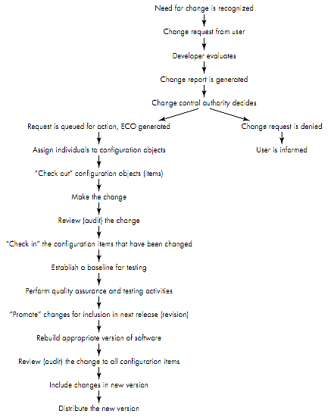

Slide 42
A change request is submitted to a configuration control authority, which is usually a change control board (CCB)
  The request is evaluated for technical merit, potential side effects, overall impact on other configuration objects and system functions, and projected cost in terms of money, time, and resources
An engineering change order (ECO) is issued for each approved change request
  Describes the change to be made, the constraints to follow, and the criteria for review and audit
  Access control governs which software engineers have the authority to access and modify a particular configuration object
  Synchronization control helps to ensure that parallel changes performed by two different people don't overwrite one another

Slide 43
Configuration auditing tasks
Configuration auditing is an SQA activity that helps to ensure that quality is maintained as changes are made
It complements the formal technical review and is conducted by the SQA group
It addresses the following questions
  Has the change specified in the ECO been made? Have any additional modifications been incorporated?
  Has a formal technical review been conducted to assess technical correctness?

Slide 44
  Has the software process been followed, and have software engineering standards been properly applied?
  Has the change been "highlighted" and "documented" in the CSCI? Have the change data and change author been specified? Do the attributes of the configuration object reflect the change?
  Have SCM procedures for noting the change, recording it, and reporting it been followed?
  Have all related CSCIs been properly updated?
A configuration audit ensures that
  The correct CSCIs(computer software configuration items) (by version) have been incorporated into a specific build
  That all documentation is up-to-date and consistent with the version that has been built

Slide 45
Status Reporting Task
Configuration status reporting (CSR) is also called status accounting
Provides information about each change to those personnel in an organization with a need to know
Answers about what happened, who did it, when did it happen, and what else will be affected?

Slide 46
Software Testing
Software testing is a process used to identify the correctness, completeness and quality of developed computer software.
The purpose of s/w testing is to ensure whether the s/w functions appear to be working according to specifications and performance requirement.

Slide 47
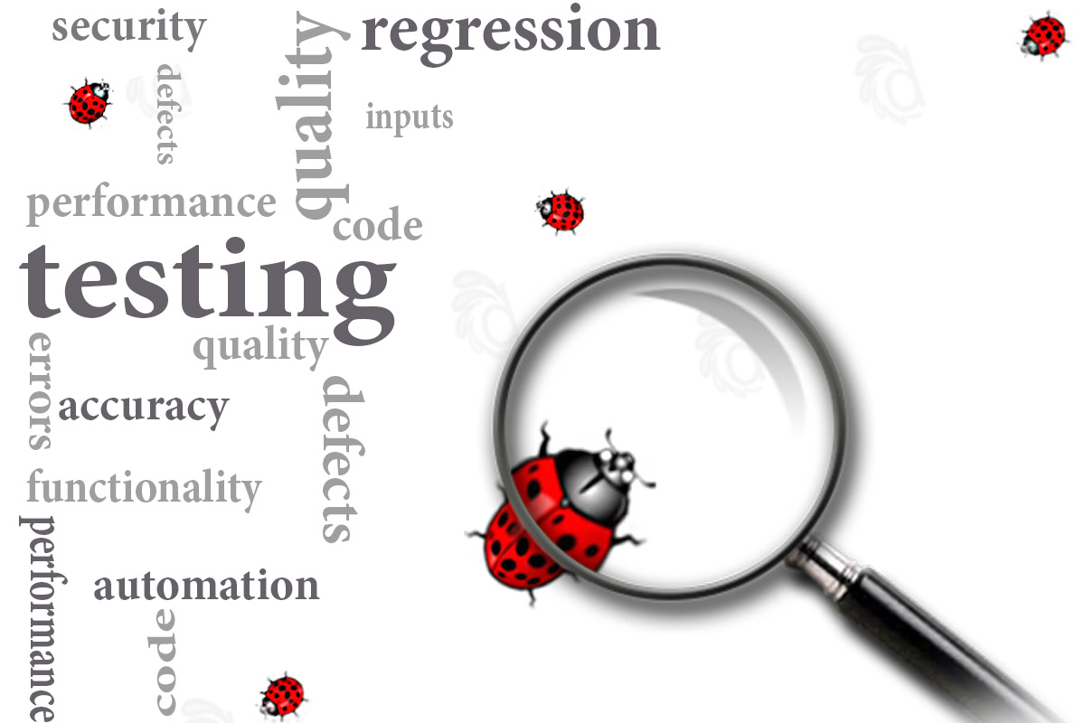
What …????
…is an ”ERROR”??
….is a ”Bug”??
….is Fault, Failure ??

Slide 48
Bug, Fault & Failure
A person makes an Error
That creates a FAULT in software
That can cause a FAILURE in operation
Error : An error is a human action that produces the incorrect result that results in a fault.
Bug : The presence of error at the time of execution of the software.
Fault : State of software caused by an error.
Failure : Deviation of the software from its expected result.

Slide 49
Why testing is important?
Bug Detection: Testing helps identify and fix defects, errors, and bugs in the software. This prevents these issues from reaching end-users, which can lead to a better user experience and lower maintenance costs.
Quality Assurance: Testing ensures that the software meets the specified quality standards and functional requirements, resulting in a higher-quality product.
User Satisfaction: Thorough testing helps deliver a product that functions as expected, providing a positive user experience. Satisfied users are more likely to continue using and recommending the software.
Security: Security testing helps identify vulnerabilities and weaknesses in the software that could be exploited by malicious actors. Fixing these vulnerabilities is essential for protecting sensitive data and maintaining trust.

Slide 50
Why testing is important?
Compliance: Testing is necessary to ensure that the software complies with industry standards, legal regulations, and specific requirements, especially in domains like healthcare, finance, and government.
Cost-Effectiveness: Identifying and fixing issues early in the development process is more cost-effective than addressing them after the software has been released. Testing helps reduce the overall cost of software development.
Risk Mitigation: Testing helps to assess and mitigate risks associated with the software, such as performance issues, data loss, or system crashes. It allows developers to address potential problems before they impact users.
Continuous Improvement: Testing is an ongoing process that provides feedback to developers. It helps them improve the software's functionality, performance, and user experience through multiple iterations.

Slide 51
A STRATEGIC APPROACH TO SOFTWARE TESTING
Strategy for software testing provides a Road Map that describes the steps to be conducted as part of testing, when these steps are planned and then undertaken, and how much effort, time, and resources will be required are estimated.
Therefore, any testing strategy must incorporate test planning, test case design, test execution, and resultant data collection and evaluation.

Slide 52
Verification and Validation
Verification refers to the set of activities that ensure that software correctly implements a specific function.
Validation refers to a different set of activities that ensure that the software that has been built is traceable to customer requirements.
State another way:
  Verification: "Are we building the product right?"
  Validation: "Are we building the right product?“
The definition of V&V encompasses many of the activities that are similar to software quality assurance (SQA).

Slide 53
Verification | Validation
Are you building it right? | Are you building the right thing?
Ensure that the software system meets all the functionality. | Ensure that functionalities meet the intended behavior.
Verification takes place first and includes the checking for documentation, code etc. | Validation occurs after verification and mainly involves the checking of the overall product.
Done by developers. | Done by Testers.
Have static activities as it includes the reviews, walkthroughs, and inspections to verify that software is correct or not. | Have dynamic activities as it includes executing the software against the requirements.
It is an objective process and no subjective decision should be needed to verify the Software. | It is a subjective process and involves subjective decisions on how well the Software works.

Slide 54
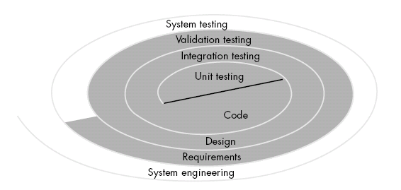
Software Testing Strategy for conventional software architecture

Slide 55
TESTING STRATEGIES FOR CONVENTIONAL SOFTWARE
Unit testing
Integration testing
  incremental
    Top down testing
    Bottom up testing
    Regression testing
  Non incremental
    big bang testing
Validation testing
  Alpha testing
  Beta testing
System testing
  Recovery testing
  Security testing
  Stress testing
  Performance testing
  Deployment Testing

Slide 56
Unit testing
Unit testing focuses verification effort on the smallest unit of software design the software component or module.
The unit test focuses on the
  internal processing logic and
  data structures within the boundaries of a component.
This type of testing can be conducted in parallel for multiple components.

Slide 57
Things to be tested
Source program
Module to be tested
Interfaces
Local data structure
Boundary conditions
Independent path
Error handling paths
Unit test considerations
Test cases
generates

Slide 58
The module interface is tested to ensure that information properly flows into and out of the program unit under test.
Local data structures are examined to ensure that data stored temporarily maintains its integrity during all steps in an algorithm’s execution

Slide 59
Boundary conditions are tested to ensure that the module operates properly at boundaries established to limit or restrict processing.
All independent paths through the control structure are exercised to ensure that all statements in a module have been executed at least once.
Finally, all error-handling paths are tested.

Slide 60
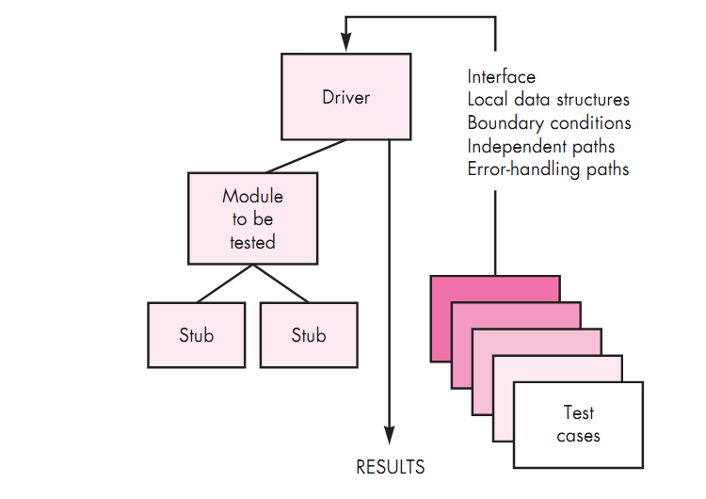
Unit test environment

Slide 61
DRIVER and STUB software need to be developed to test incomplete software.
DRIVER:
Drivers Suppose a module is to be tested, wherein some inputs are to be received from another module.
However, this module which passes inputs to the module to be tested is not ready and under development.
In such a situation, we need to simulate the inputs required in the module to be tested.
For this purpose, a main program is prepared, wherein the required inputs are either hard-coded or entered by the user and passed on to the module under test.
This module where the required inputs for the module under test are simulated for the purpose of module or unit testing is known as a driver module,
The driver module may print or interpret the results produced by the module under testing.

Slide 62
STUB:
Stubs The module under testing may also call some other module which is not ready at the time of testing.
Therefore, these modules need to be simulated for testing.
In most cases, dummy modules instead of actual modules, which are not ready, are prepared for these subordinate modules.
These dummy modules are called stubs.
Thus, a stub can be defined as a piece of software that works similar to a unit which is referenced by the unit being tested, but it is much simpler than the actual unit.

Slide 63
Drivers and stubs represent testing “overhead.” That is, both are software that must be written but that is not delivered with the final software product.
If drivers and stubs are kept simple, actual overhead is relatively low.
Unfortunately, many components cannot be properly unit tested with “simple” overhead software.
In such cases, complete testing can be postponed until the integration test step

Slide 64
Integration testing
Integration testing is a systematic technique for constructing the software architecture while at the same time conducting tests to uncover errors associated with interfacing.
The objective is to take unit-tested components and build a program Structure that has been dictated by design.

Slide 65
INTEGRATION TESTING
NON- INCREMENTAL
BIG-BANG
INCREMENTAL
TOP-DOWN TESTING
BOTTOM UP TESTING
REGRESSION TESTING

Slide 66
Big bang testing
Big Bang Integration Testing is an integration testing strategy where all units are linked at once, resulting in a complete system.
When this type of testing strategy is adopted, it is difficult to isolate any errors found, because attention is not paid to verifying the interfaces across individual units.

Slide 67
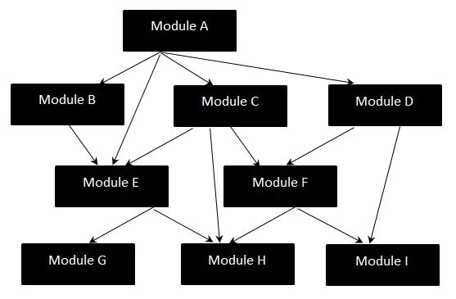

Slide 68
Disadvantages of Big-Bang Testing
Defects present at the interfaces of components are identified at very late stage as all components are integrated in one shot.
It is very difficult to isolate the defects found.
There is high probability of missing some critical defects, which might pop up in the production environment.
It is very difficult to cover all the cases for integration testing without missing even a single scenario.

Slide 69
Top down testing
Top-down integration testing is an integration testing technique used in order to simulate the behavior of the lower-level modules that are not yet integrated.
Stubs are the modules that act as temporary replacement for a called module and give the same output as that of the actual product.
The replacement for the 'called' modules is known as 'Stubs' and is also used when the software needs to interact with an external system.

Slide 70
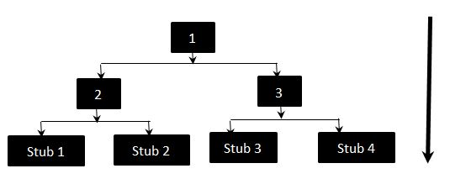

Slide 71
The above diagrams clearly states that Modules 1, 2 and 3 are available for integration, whereas, below modules are still under development that cannot be integrated at this point of time.
Hence, Stubs are used to test the modules.
The order of Integration will be:
  1,2
  1,3
  2,Stub 1
  2,Stub 2
  3,Stub 3
  3,Stub 4

Slide 72
Bottom Up Testing
Each component at lower hierarchy is tested individually and then the components that rely upon these components are tested.
The order of Integration by Top-down approach will be:
  4,2
  5,2
  6,3
  7,3
  2,1
  3,1

Slide 73
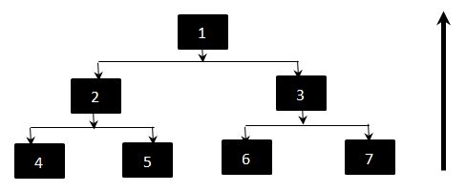

Slide 74
Regression testing
Regression testing is the re-execution of some subset of tests that have already been conducted to ensure that changes have not propagated unintended side effects.
Regression testing helps to ensure that changes do not introduce unintended behavior or additional errors.
It is used to check for defects propagated to other modules by changes made to existing system
Thus regression testing is used to reduce the side effect of changes.

Slide 75
Regression test suite
The regression test suite contains three different classes of test cases:
A representative sample of tests that will utilize all software functions.
Additional tests that focus on software functions that are likely to be affected by the change.
Tests that focus on the software components that have been changed.

Slide 76
It is impractical and inefficient to re-execute every test for every program function once a change has occurred.
Therefore, the regression test suite should be designed to include only those tests that address one or more classes of errors in each of the major program functions.

Slide 77
System testing
This is the next level in the testing which tests the system as a whole.
Once all the components are integrated, the application as a whole is tested to see that it meets Quality Standards.
  Recovery testing
  Security testing
  Performance testing
  Stress testing
  Deployment testing

Slide 78
Recovery testing
Recovery testing is a type of non-functional testing technique performed in order to determine how quickly the system can recover after it has gone through system crash or hardware failure.
Recovery testing is the forced failure of the software to verify if the recovery is successful

Slide 79
Security testing
Security testing is a testing technique to determine if an information system protects data and maintains functionality as intended.
During security testing, the tester plays the role(s) of the individual who desires to penetrate the system.
Security Testing - Techniques:
  Injection
  Broken Authentication and Session Management
  Cross-Site Scripting (XSS)
  Security Misconfiguration
  Cross-Site Request Forgery (CSRF)
  Unvalidated Redirects and Forwards

Slide 80
Performance testing
Performance testing, a non-functional testing technique performed
  to test the run-time performance of software ,
  to determine the system parameters in terms of responsiveness and
  stability under various workload.
Performance testing occurs throughout all steps in the testing process
Performance tests are often coupled with stress testing and usually require both hardware and software instrumentation

Slide 81
It is mostly used to identify any bottlenecks or performance issues rather than finding the bugs in software.
Performance Testing Tools
  Jmeter - http://jmeter.apache.org/
  Open STA - http://opensta.org

Slide 82
Stress testing
Stress testing a Non-Functional testing technique that is performed as part of performance testing.
During stress testing, the system is monitored after subjecting the system to overload to ensure that the system can sustain the stress.
It is performed to find the upper limit capacity of the system and also to determine how the system performs if the current load goes well above the expected maximum.

Slide 83
Reasons for conducting Stress Testing:
  It allows the test team to monitor system performance during failures.
  To verify if the system has saved the data before crashing or NOT.
  To verify if the system prints meaning error messages while crashing or did it print some random exceptions.
  To verify if unexpected failures do not cause security issues.

Slide 84
Stress Testing - Scenarios:
  Monitor the system behavior when maximum number of users logged in at the same time.
  All users performing the critical operations at the same time.
  All users Accessing the same file at the same time.
  Hardware issues such as database server down

Slide 85
Deployment testing
In many cases, software must execute on a variety of platforms and under more than one operating system environment.
Deployment testing, sometimes called configuration testing, exercises the software in each environment in which it is to operate.
In addition, deployment testing examines all installation procedures and specialized installation software that will be used by customers, and all documentation that will be used to introduce the software to end users.

Slide 86
Validation testing
Validation testing begins at the conclusion of integration testing, when individual components have been implemented, the software is completely assembled as a package, and interfacing errors have been uncovered and corrected.
  Alpha Testing
  Beta Testing

Slide 87
Alpha testing
Unit testing, integration testing and system testing when combined are known as alpha testing.
During this phase, the following will be tested in the application:
  Spelling Mistakes
  Broken Links
  Cloudy Directions

Slide 88
Alpha testing takes place at the developer's site by the internal teams, before release to external customers.
Alpha testing is carried out in a lab environment
Usually the testers are internal employees of the organization.
To put it as simple as possible, this kind of testing is called alpha only because it is done early on, near the end of the development of the software, and before beta testing.

Slide 89
Advantages & Disadvantages
Advantages of Alpha Testing:
  Provides better view about the software at an early stage
  Helps simulate real time user behavior and environment.
  Detect many showstopper or serious errors
  Ability to provide early detection of errors with respect to design and functionality
Disadvantages of Alpha Testing:
  In depth functionality cannot be tested as software is still under development stage Sometimes developers and testers are dissatisfied with the results of alpha testing

Slide 90
Beta testing
Beta version of the software is released to a limited number of end-users of the product to obtain feedback on the product quality.
Beta testing takes place at the end users site by the end users to validate the usability, functionality, compatibility, and reliability testing
Beta testing reduces product failure risks and provides increased quality of the product through customer validation.
It is the final test before shipping a product to the customers.
Direct feedback from customers is a major advantage of Beta Testing.
This testing helps to tests the product in real time environment.

Slide 91
Advantages & Disadvantages
Advantages Beta Testing
  Reduces product failure risk via customer validation.
  Beta Testing allows a company to test post-launch infrastructure.
  Improves product quality via customer feedback
  Cost effective compared to similar data gathering methods
  Creates goodwill with customers and increases customer satisfaction
Disadvantages Beta Testing
  Test Management is an issue. As compared to other testing types which are usually executed inside a company in a controlled environment, beta testing is executed out in the real world
  Finding the right beta users and maintaining their participation could be a challenge

Slide 92
Alpha Testing | Beta Testing
Alpha testing performed by Testers who are usually internal employees of the organization | Beta testing is performed by Clients or End Users who are not employees of the organization
Alpha Testing performed at developer's site | Beta testing is performed at client location or end user of the product
Reliability and security testing are not performed in-depth Alpha Testing | Reliability, Security, Robustness are checked during Beta Testing
Alpha testing involves both the white box and black box techniques | Beta Testing typically uses black box testing
Alpha testing requires lab environment or testing environment | Beta testing doesn't require any lab environment or testing environment. Software is made available to the public and is said to be real time environment
Long execution cycle may be required for Alpha testing | Only few weeks of execution are required for Beta testing
Critical issues or fixes can be addressed by developers immediately in Alpha testing | Most of the issues or feedback is collected from Beta testing will be implemented in future versions of the product
Alpha testing is to ensure the quality of the product before moving to Beta testing | Beta testing also concentrates on quality of the product, but gathers users input on the product and ensures that the product is ready for real time users.

Slide 93
White box
White box testing is the detailed investigation of internal logic and structure of the code.
White box testing is also called glass testing or open box testing.
The "status of the program" will be examined at various points.
In order to perform white box testing on an application, the tester needs to possess knowledge of the internal working of the code.

Slide 94
White box testing includes
Basic path testing
  Flow Graph Notation
  Independent Program Paths
  Graph Matrices
control Structure Testing
  Condition Testing
  Loop Testing

Slide 95
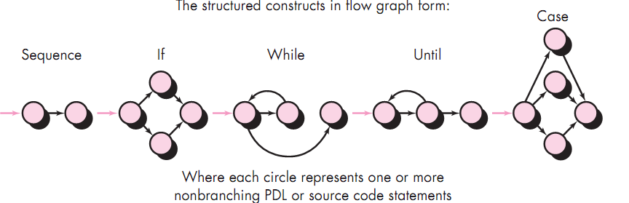
BASIS PATH TESTING
Flow Graph Notation

Slide 96
Each circle, called a flow graph node, represents one or more procedural statements.
A sequence of process boxes and a decision diamond can map into a single node.
The arrows on the flow graph, called edges or links, represent flow of control and are analogous to flowchart arrows.
An edge must terminate at a node, Even if the node does not represent any procedural statements
Areas bounded by edges and nodes are called regions.
When counting regions, include the area outside the graph as a region.

Slide 97
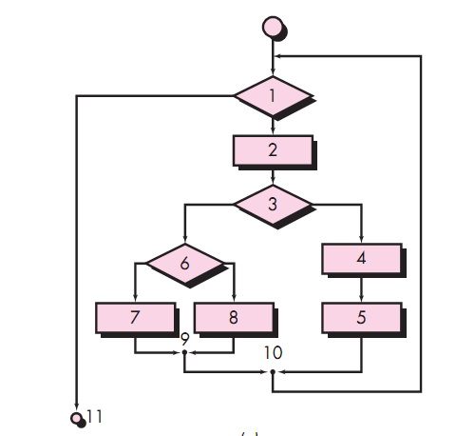
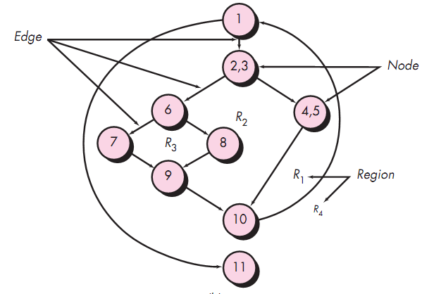
Flow chart to flow graph notation

Slide 98
Source code to Flow Graph
3
1 int functionY(void)
2 {
3 int x = 0;
4 int y = 19;
5 A: x++;
6 if (x > 999)
7 goto D;
8 if (x % 11 == 0)
9 goto B;
10 else goto A;
11 B: if (x % y == 0)
12 goto C;
13 else goto A;
14 C: printf("%d\n", x);
15 goto A;
16 D: printf("End of list\n");
17 return 0;
18 }
4
5
6
8
7
10
9
16
11
17
13
12
14
15

Slide 99
Independent Program Paths
An independent path is any path through the program that introduces at least one new set of processing statements or a new condition.
When stated in terms of a flow graph, an independent path must move along at least one edge that has not been traversed before the path is defined.

Slide 101
Path 1: 1-11
Path 2: 1-2-3-4-5-10-1-11
Path 3: 1-2-3-6-8-9-10-1-11
Path 4: 1-2-3-6-7-9-10-1-11
Note that each new path introduces a new edge.
The path 1-2-3-4-5-10-1-2-3-6-8-9-10-1-11 is not considered to be an independent path because it is simply a combination of already specified paths and does not traverse any new edges.

Slide 102
Cyclomatic complexity
How do you know how many paths to look for?
The computation of cyclomatic complexity provides the answer
Cyclomatic complexity is a software metric that provides a quantitative measure of the logical complexity of a program.
When used in the context of the basis path testing method, the value computed for cyclomatic complexity defines the number of independent paths in the basis set of a program and provides with an upper bound for the number of tests that must be conducted to ensure that all statements have been executed at least once.

Slide 103
Complexity is computed in one of three ways
The number of regions of the flow graph corresponds to the cyclomatic complexity.
Cyclomatic complexity V(G) for a flow graph G is defined as
  V(G) = E-N+2
    where
    E is the number of flow graph edges and
    N is the number of flow graph nodes.
Cyclomatic complexity V(G) for a flow graph G is also defined as
  V(G)=P+1
  where P is the number of predicate nodes contained in the flow graph G.

Slide 104
The flow graph has four regions.
V(G)=11 edges - 9 nodes+2=4.
V(G)=3 predicate nodes+1=4.

Slide 105
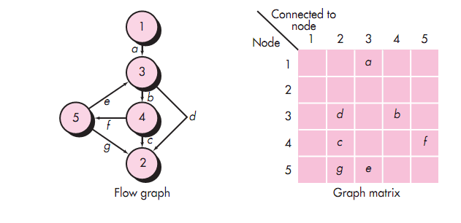
Graph Matrices
A graph matrix is a square matrix whose size (i.e., number of rows and columns) is equal to the number of nodes on the flow graph. Each row and column corresponds to an identified node, and matrix entries correspond to connections (an edge) between nodes.

Slide 106
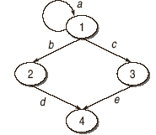
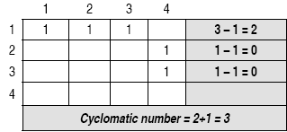
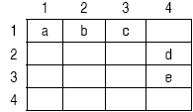
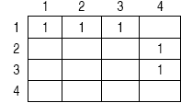

Slide 107
CONTROL STRUCTURE TESTING
Condition Testing
  =,<,>,<=,>=,!=
Loop Testing
  Simple loops.
    Skip the loop entirely.
    Only one pass through the loop.
    Two passes through the loop.
    m passes through the loop where m<n.
    n -1, n, n+1 passes through the loop.
  Nested loop
    Start at the innermost loop.
    Conduct simple loop tests for the innermost loop while holding the outer loops at their minimum iteration parameter
    continue until all loops have been tested.

Slide 108
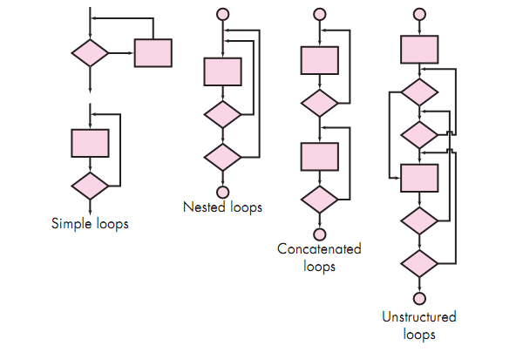

Slide 109
Advantages:
It helps in optimizing the code.
Extra lines of code can be removed which can bring in hidden defects.
It helps in evaluating all the loops and paths.

Slide 110
Disadvantages:
Due to the fact that a skilled tester is needed to perform white box testing, the costs are increased.
Sometimes it is impossible to look into every nook and corner to find out hidden errors that may create problems as many paths will go untested.
It is difficult to maintain white box testing as the use of specialized tools like code analyzers and debugging tools are required.
It takes time to tester to develop the test cases.
Test cases are a waste if changes in the implementation code are done frequently.

Slide 111
Black box testing methods
  Equivalence partitioning
  Boundary value analysis (BVA)

Slide 112
Equivalence partitioning
Equivalence partitioning is a software testing technique that divides the input and/or output data of a software unit into partitions of data from which test cases can be derived.
The equivalence partitions are usually derived from the requirements specification for input attributes that influence the processing of the test object.
Test cases are designed to cover each partition at least once.
Test case design is based on an evaluation of equivalence classes for an input condition
An equivalence class represents a set of valid or invalid states for input conditions

Slide 113
What can be found using equivalence partitioning?
Equivalence partitioning technique uncovers classes of errors.
Testing uncovers sets of inputs that causes errors or failures, not just individual inputs.

Slide 114
What can be partitioned?
Usually it is the input data that is partitioned.
However, depending on the software unit to be tested, output data can be partitioned as well.
Each partition shall contain a set or range of values, chosen such that all the values can reasonably be expected to be treated by the component in the same way (i.e. they may be considered ‘equivalent’).

Slide 115
Equivalence partitioning example
Example of a function which takes a parameter “month”.
The valid range for the month is 1 to 12, representing January to December. This valid range is called a partition.
In this example there are two further partitions of invalid ranges.
x < 1
1 ≤ x ≤ 12
12 < x

Slide 116
Equivalence partitioning example
Test cases are chosen so that each partition would be tested.
-2
5
17
x < 1
1 ≤ x ≤ 12
12 < x

Slide 117
Boundary value analysis
Equivalence partitioning is not a stand alone method to determine test cases. It is usually supplemented by boundary value analysis.
A greater number of errors occur at the boundaries of the input domain rather than in the "center"
Boundary value analysis focuses on values on the edge of an equivalence partition or at the smallest value on either side of an edge.

Slide 118
Equivalence partitioning with boundary value analysis
We use the same example as before.
Test cases are supplemented with boundary values.
-2
1
5
12
17
0
2
11
13
x < 1
1 ≤ x ≤ 12
12 < x

Slide 119
 | Black Box Testing | Grey Box Testing | White Box Testing
1. | The Internal Workings of an application are not required to be known | Somewhat knowledge of the internal workings are known | Tester has full knowledge of the Internal workings of the application
2. | Also known as closed box testing, data driven testing and functional testing | Another term for grey box testing is translucent testing as the tester has limited knowledge of the insides of the application | Also known as clear box testing, structural testing or code based testing
3. | Performed by end users and also by testers and developers | Performed by end users and also by testers and developers | Normally done by testers and developers
4. | -Testing is based on external expectations -Internal behavior of the application is unknown | Testing is done on the basis of high level database diagrams and data flow diagrams | Internal workings are fully known and the tester can design test data accordingly
5. | This is the least time consuming and exhaustive | Partly time consuming and exhaustive | The most exhaustive and time consuming type of testing
6. | Not suited to algorithm testing | Not suited to algorithm testing | Suited for algorithm testing
7. | This can only be done by trial and error method | Data domains and Internal boundaries can be tested, if known | Data domains and Internal boundaries can be better tested

